Slide 1
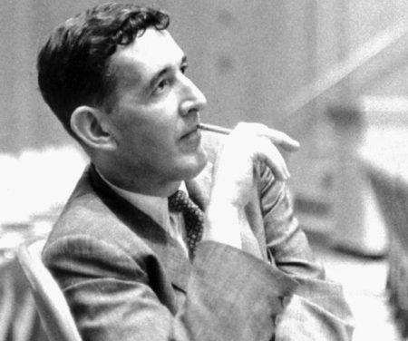
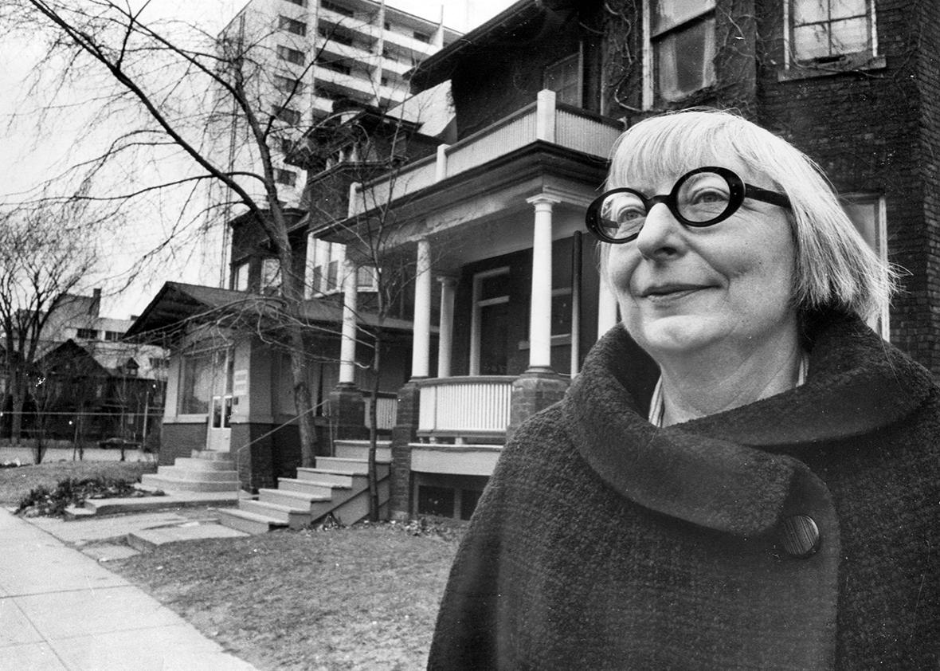
The Deep Roots of Creative Placemaking

Slide 2
Both of these pieces…..
Are almost 60 years old.
That’s a long time ago!
Thoughts?
Did they seem relevant?

Slide 3
William H. Whyte
1917-1999
was an American urbanist, organizational analyst, journalist, and people-watcher.
This excerpt came from his 1956 book Organization Man.
Much of his career was spend studying the city; this is a book about the American suburbs.
What placemaking should not be….

Slide 4
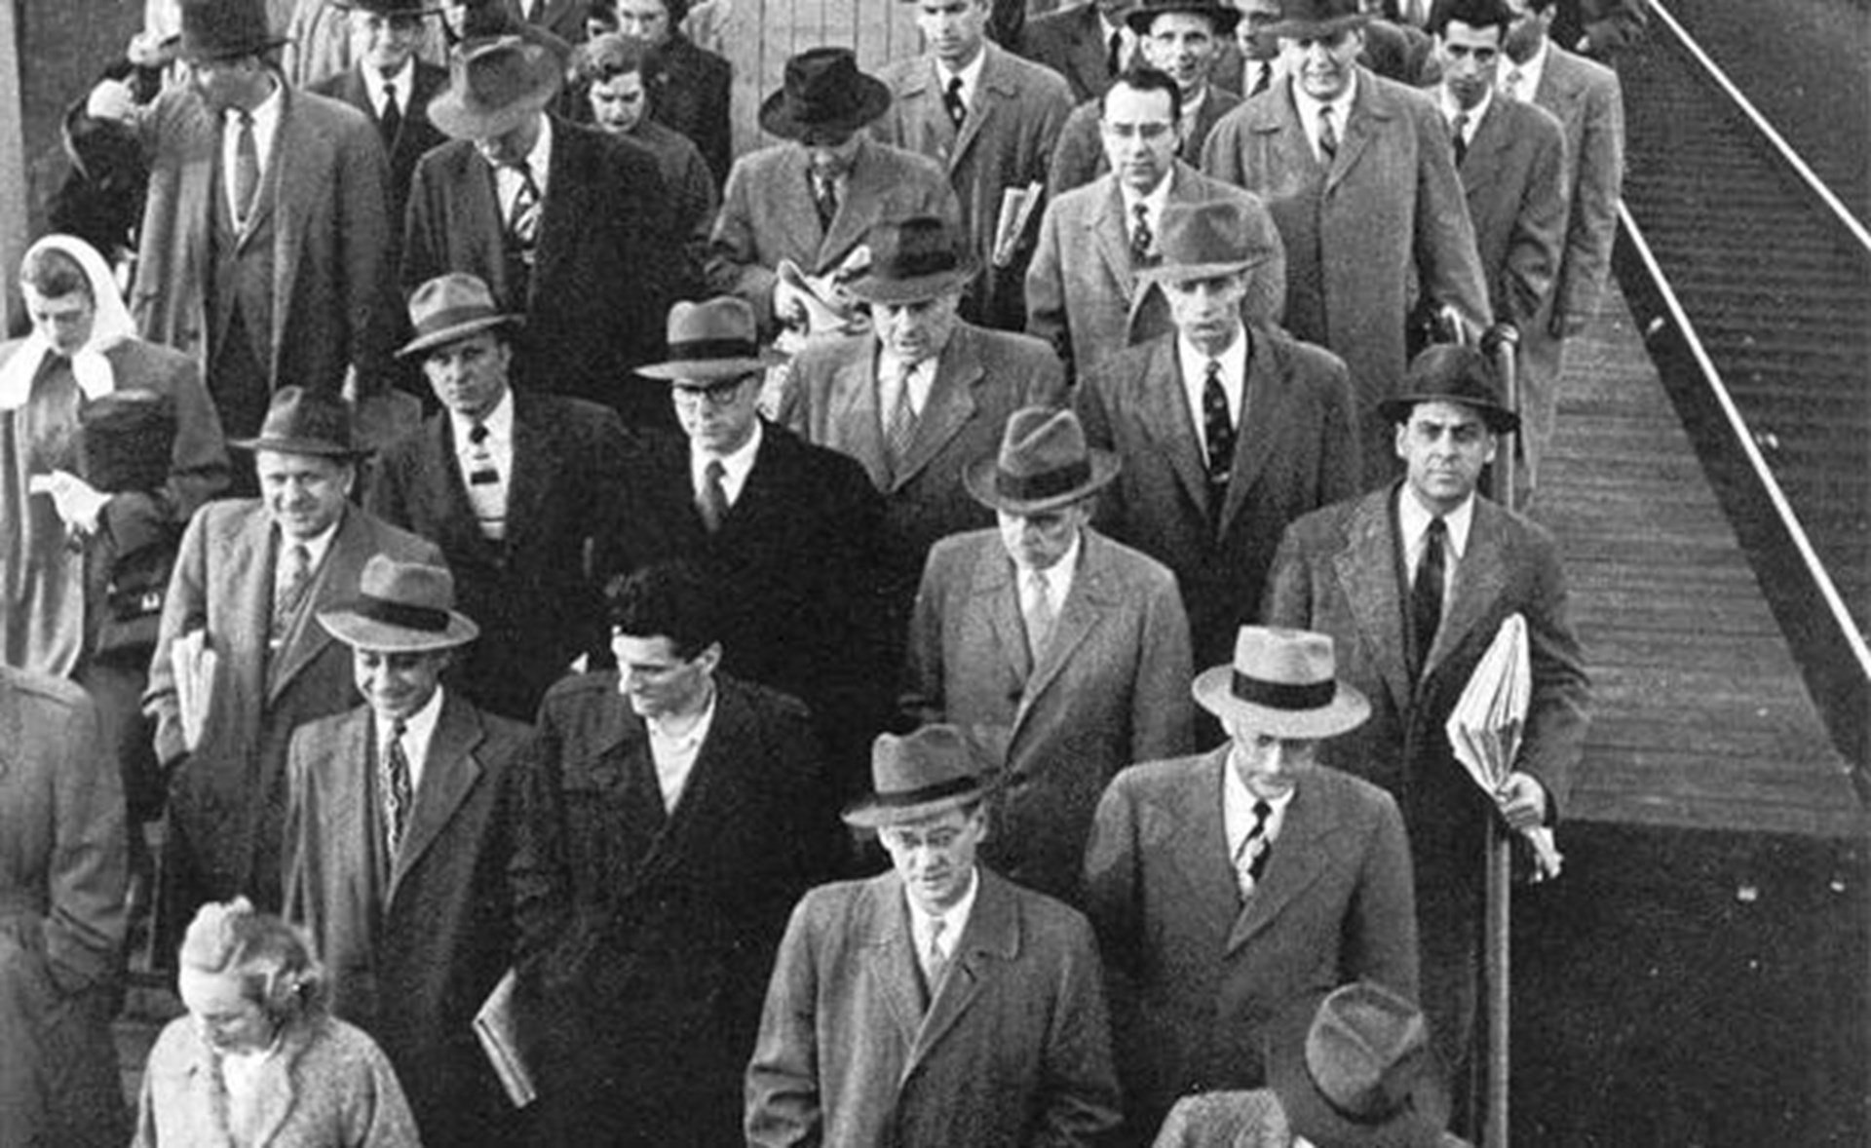
Organization Man

Slide 5
And the post-World War II rise….
Of the “Organization.”
Large corporations like General Motors, IBM, and Boeing.
The workers in such corporations “have no great sense of plight; between themselves and organization they believe they see an ultimate harmony and, more than most elders recognize, they are building an ideology that will vouchsafe this trust.”
What might this mean?

Slide 6
Repercussions of this?
Critics saw the potential danger of them growing too big (monopolies, etc), but more:
“These are proper concerns, but no less important is the principal impact that organization life has had on the individuals within it. A collision has been taking place indeed, hundreds of thousands of them, and in the aggregate they have been producing what I believe is a major shift in American ideology.”
What is this doing to people – and how they live?

Slide 7
From the Protestant Ethic….
To the Social Ethic.
“[I]t could be called an organization ethic, or a bureaucratic ethic; more than anything else it rationalizes the organization's demands for fealty and gives those who offer it wholeheartedly a sense of dedication in doing so—in extremis, you might say, it converts what would seem in other times a bill of no rights into a restatement of individualism.”
What to make of this shift?

Slide 8
And it serves to control….
“By Social Ethic I mean that contemporary body of thought which makes morally legitimate the pressures of society against the individual. Its major propositions are three: a belief in the group as the source of creativity; a belief in ‘belongingness’ as the ultimate need of the individual; and a belief in the application of science to achieve the belongingness.”

Slide 9
But why does this matter to us?
To Whyte, the American suburb has emerged as the space of Organization Man and the Social Ethic.
“Whatever kind of future suburbia may foreshadow, it will show that at least we have choices to make. The organization man is not in the grip of vast social forces about which it is impossible for him to do anything; the options are there, and with wisdom and foresight he can turn the future away from the dehumanized collective that so haunts our thoughts. He may not. But he can.”
Why might the suburb be the perfect place for such people and ideas?

Slide 10
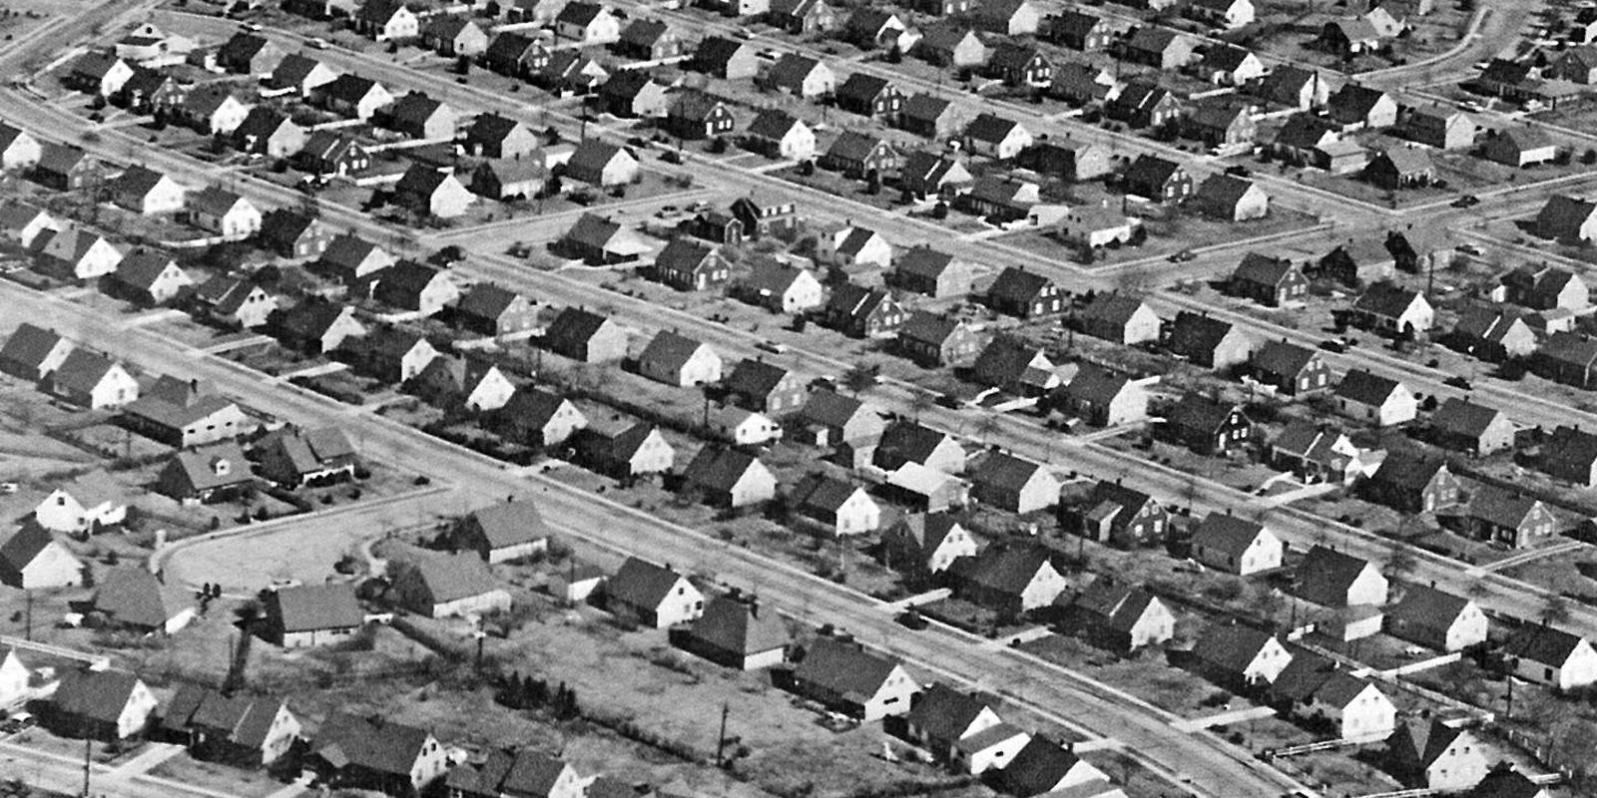
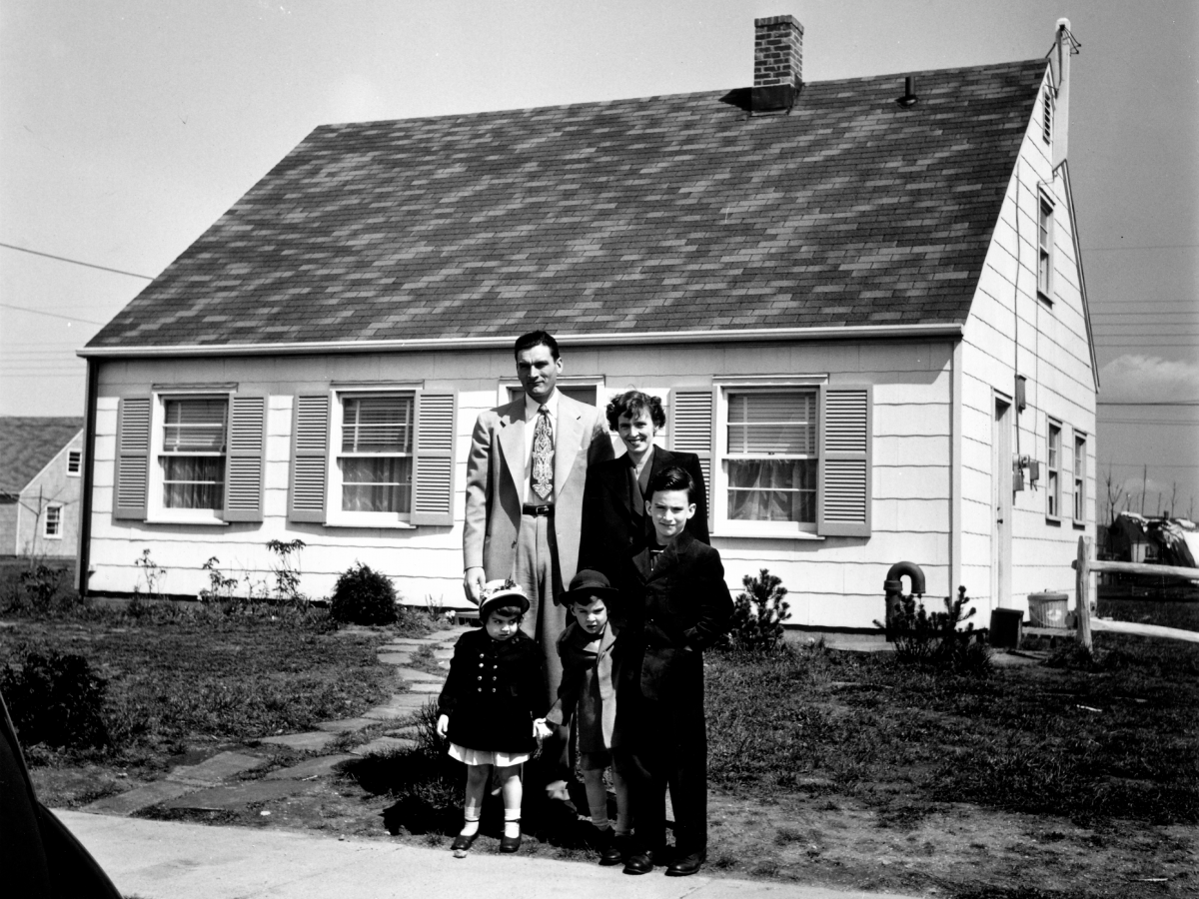
How do we think about the (1950s) suburbs?

Slide 11
Elsewhere in Organization Man….
Whyte noted how these suburban dwellers were simultaneously quite aware of the “impermanence” of such spaces; fear of rapid “turnover” in suburban homes and rental units, for example, was on the minds of many such individuals, as these new workers could be moved at the whim of the Organization. Such realities meant that “Psychologically, at least, the newcomers to suburbia are living on the brink of a precipice.”
Ultimately, “As far as social values are concerned, suburbia is the ultimate expression of the interchangeability so sought by organization.”
Here in suburbia were the breeding grounds for workers who would spend their lives within the bureaucracy of the large-scale corporation. The suburbs taught such workers to get along with each other – but not to get too close – while dampening any sort of individual initiative or thought.

Slide 12
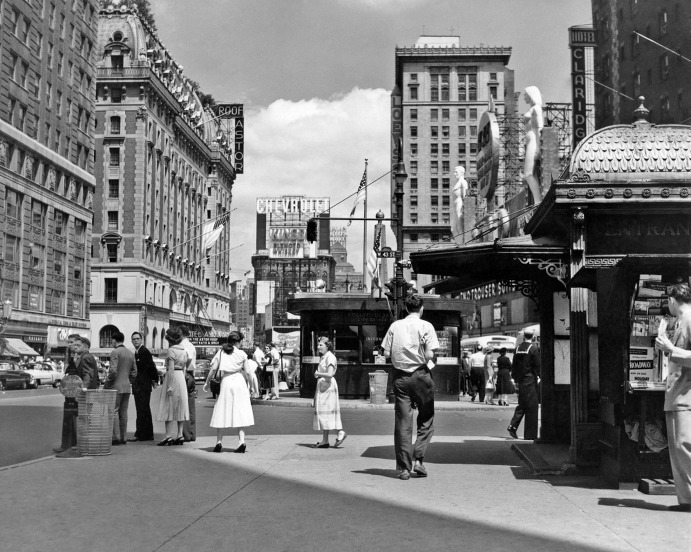
The answer?

Slide 13
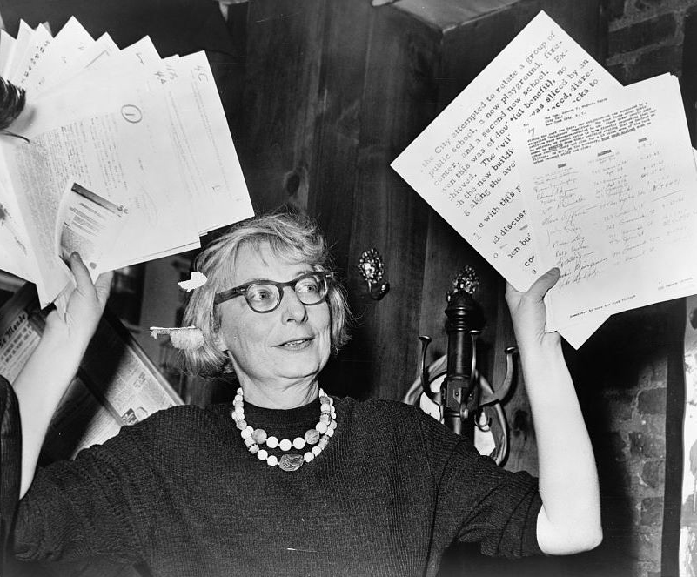
And Jane Jacobs….

Slide 14
Jacobs….
1916-2006
Was a journalist, author, and activist who influenced urban studies, sociology, and economics.
Her book The Death and Life of Great American Cities (1961) – which we read from – is seen as important source for contemporary creative placemaking projects.
As a mother and a writer who criticized experts in the male-dominated field of urban planning, Jacobs endured scorn from professionals.
She was described as a housewife first and did not have a college degree or any formal training in urban planning.
Her lack of credentials was seized upon as grounds for criticism – but also as an asset. Why?

Slide 15
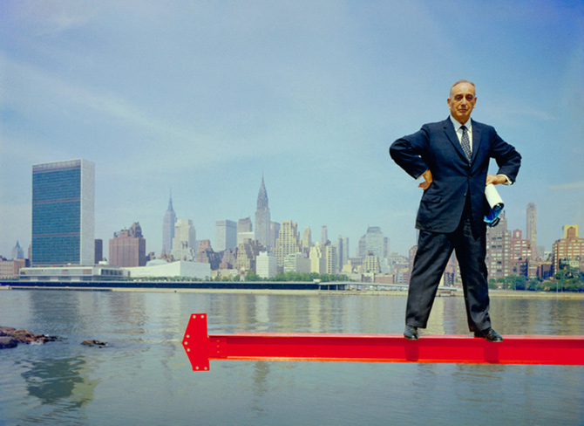
Often portrayed as battling….

Slide 16
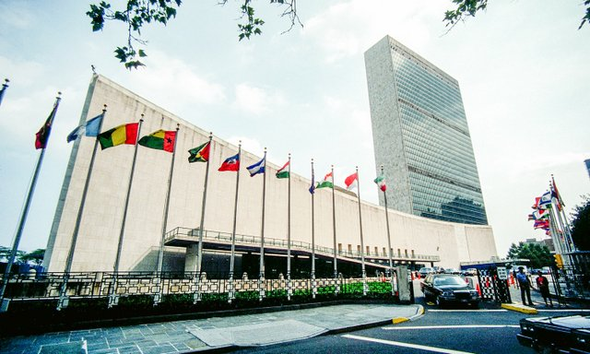
Behind buildings like this….

Slide 17
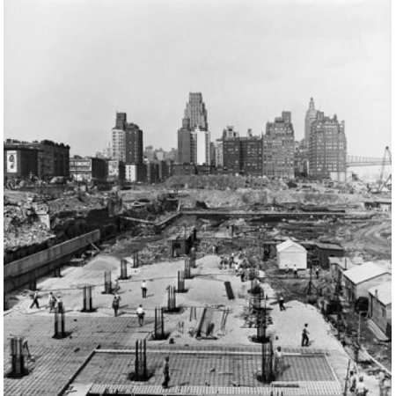
But what this took….

Slide 18
In the “Introduction”….
To The Death and Life of Great American Cities:
“This book is an attack on current city planning and rebuilding.”
“It is an attack, rather, on the principles and aims that have shaped modern, orthodox city planning and rebuilding.”
What do you think she means here?

Slide 19
Money is not the answer….
“But look what we have built with the first several billions: Low-income projects that become worse centers of delinquency, vandalism and general social hopelessness than the slums they were supposed to replace. Middle-income housing projects which are truly marvels of dullness and regimentation, sealed against any buoyancy or vitality of city life. Luxury housing projects that mitigate their inanity, or try to, with a vapid vulgarity. Cultural centers that are unable to support a good bookstore. Civic centers that are avoided by everyone but bums, who have fewer choices of loitering place than others. Commercial centers that are lackluster imitations of standardized suburban chain-store shopping. Promenades that go from no place to nowhere and have no promenaders. Expressways that eviscerate great cities. This is not the rebuilding of cities. This is the sacking of cities.”
Why might contemporary placemakers take inspiration from this?

Slide 20
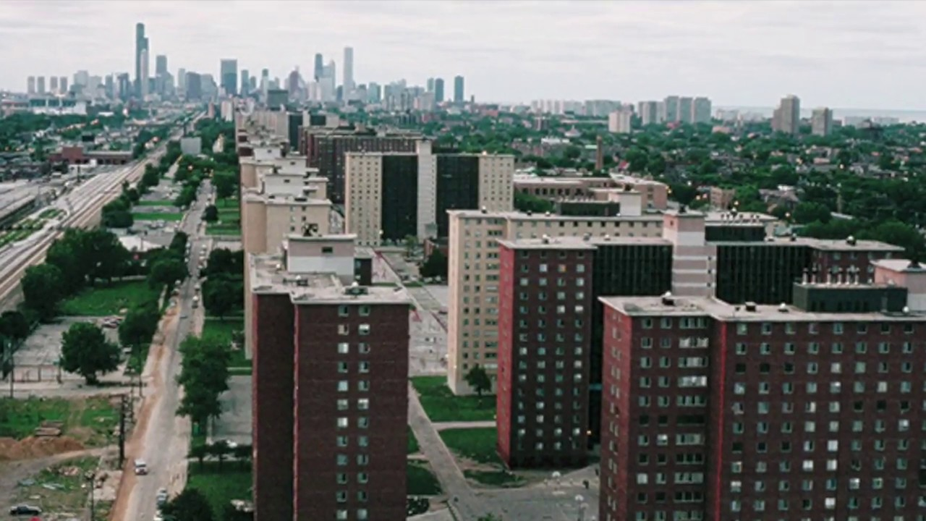
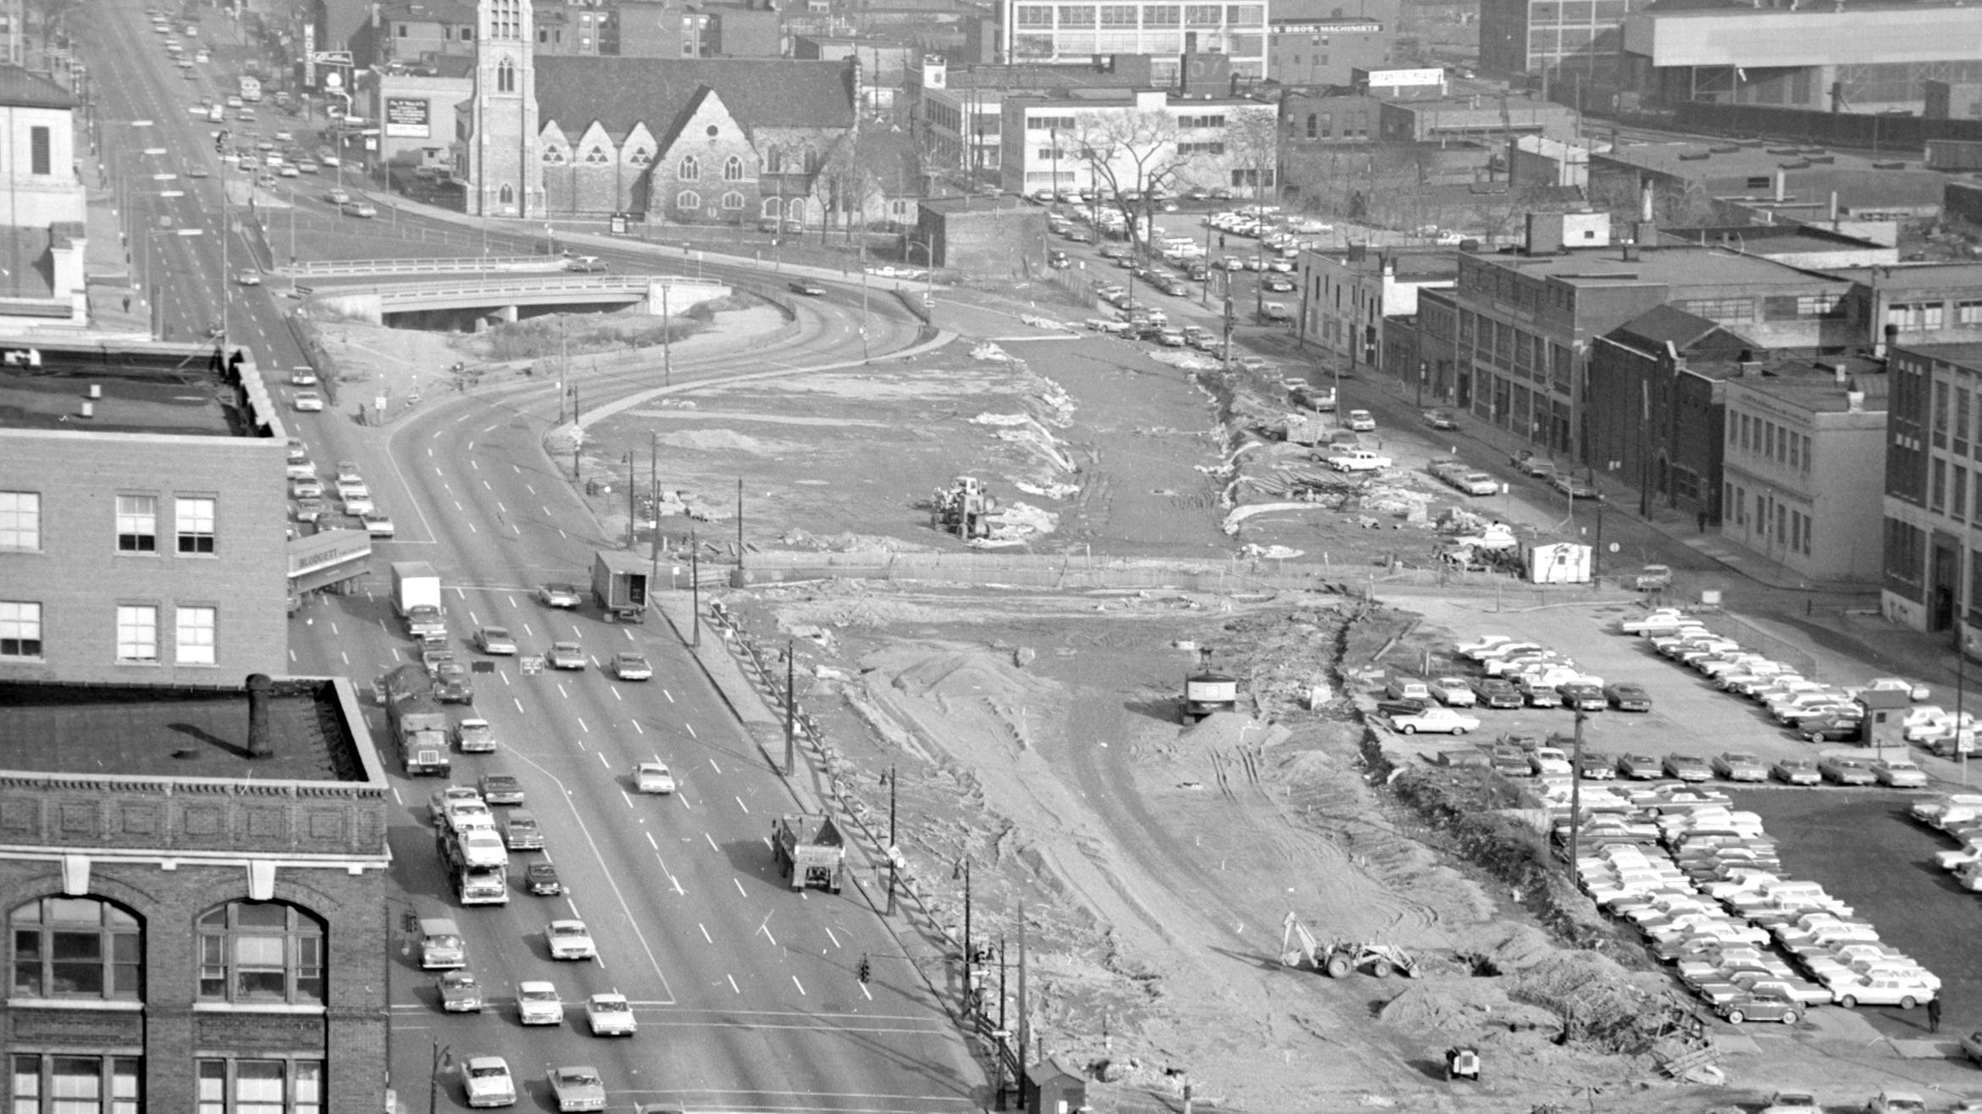
What she was talking about…..

Slide 21
So if the suburb wasn’t the ideal place….
Neither was the mid-twentieth century city, as described by Jacobs.
The era of “urban renewal” – what was it?

Slide 22
And it didn’t seem to be working….
“Meantime, all the art and science of city planning are helpless to stem decay—and the spiritlessness that precedes decay—in ever more massive swatches of cities.”
Why? Because no one ever paid attention to how good cities actually looked and worked:
“Instead the practitioners and teachers of this discipline (if such it can be called) have ignored the study of success and failure in real life, have been incurious about the reasons for unexpected success, and are guided instead by principles derived from the behavior and appearance of towns, suburbs, tuberculosis sanatoria, fairs, and imaginary dream cities—from anything but cities themselves.”

Slide 23
The automobile is somewhat at fault here….
As we have planned our cities around them (and look at Milwaukee, for example).
But the issue is bigger than that:
“How can you know what to try with traffic until you know how the city itself works, and what else it needs to do with its streets? You can’t.”
What else do streets do?

Slide 24
But what do cities need?
“the need of cities for a most intricate and close-grained diversity of uses that give each other constant mutual support, both economically and socially.”
Sound familiar?

Slide 25
Instead….
The city of the mid-twentieth century was a “Great Blight of Dullness.”
(Similar to the suburb, which it was trying to replicate).
So how to address this?

Slide 26
Fight the dullness!
In light of such sterile environments, Jacobs wrote of the value of urban “Eye-catchers,” spaces that provided color to their drab surroundings. “Some eye-catchers,” Jacobs found, “are eye-catchers just by virtue of what they are…Other eye-catchers, however, are eye-catchers because of precisely where they are,” with both types being valuable to a city’s built environment.
Again, sound familiar?

Slide 27
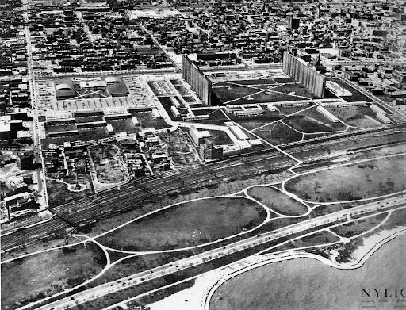
Move away from single-use spaces….

Slide 28
To Jacobs….
Single-use spaces, often maintained through deliberate zoning restrictions, only worked to create dead zones, or places where people did not want to congregate.
Public housing in American cities, with its rejection of mixed-use planning, provided ample evidence for Jacobs here. To counter such damaging social isolation, “Effective diversity of use, drawing deliberately a sequence of diversified users, must be deliberately introduced” into public urban spaces.
This meant that the city should be working to create spaces that hosted such diverse activities as ice skating, washing bikes, roasting pigs(!), and street vending of a variety of products.
Such “Deliberate street arrangements for vendors can be full of life, attraction and interest,” and, as Jacobs argued, would bring together a remarkable mix of disparate city dwellers.
THIS is why creative placemaking draws from her work….

Slide 29
And a place for old buildings….
Old buildings, previously seen as blight, were recast by Jacobs as spaces of opportunity.
And she was not simply advocating for the use of “museum-piece” old buildings, though such structures could be culturally significant and therefore useful to a community’s overall health. Jacobs also saw great value in maintaining “a good lot of plain, ordinary, low-value old buildings, including some rundown old buildings.”
These buildings, with their low cost of entry, would allow all sorts of enterprises to literally set up shop.

Slide 30
This is adaptive reuse….
Or old buildings being used for entirely new purposes
Such urban spaces should be thought of as the logical birth places for new entrepreneurial endeavors. It was in such repurposed spaces that small-scale start-up firms could plant their roots. “Wherever lively and popular parts of cities are found,” Jacob found, “the small [enterprises] much outnumber the large.” Perhaps more importantly, these spaces allowed for creativity and innovation to be developed by those often priced out of big cities.
Such environments, Jacobs concluded, “are natural generators of diversity and prolific incubators of new enterprises and ideas of all kinds.”
The roots of placemaking as economic development?

Slide 31
And such activity….
Gave new use to both streets and sidewalks.
How do we usually think about such spaces?
And how might Jacobs?
They put “eyes upon the street.”
“A well-used city street is apt to be a safe street. A deserted city street is apt to be unsafe.”
Remember Ann Markusen talking about placemaking and public safety…..

Slide 32
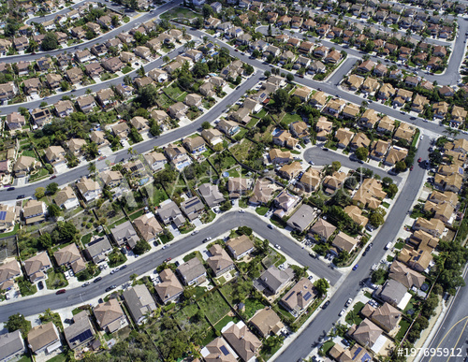
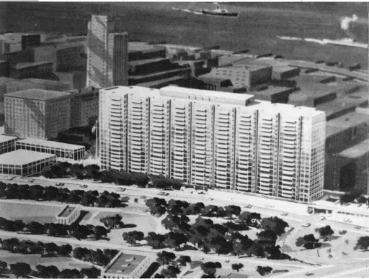
Through Whyte and Jacobs – what placemaking isn’t…..

Slide 33
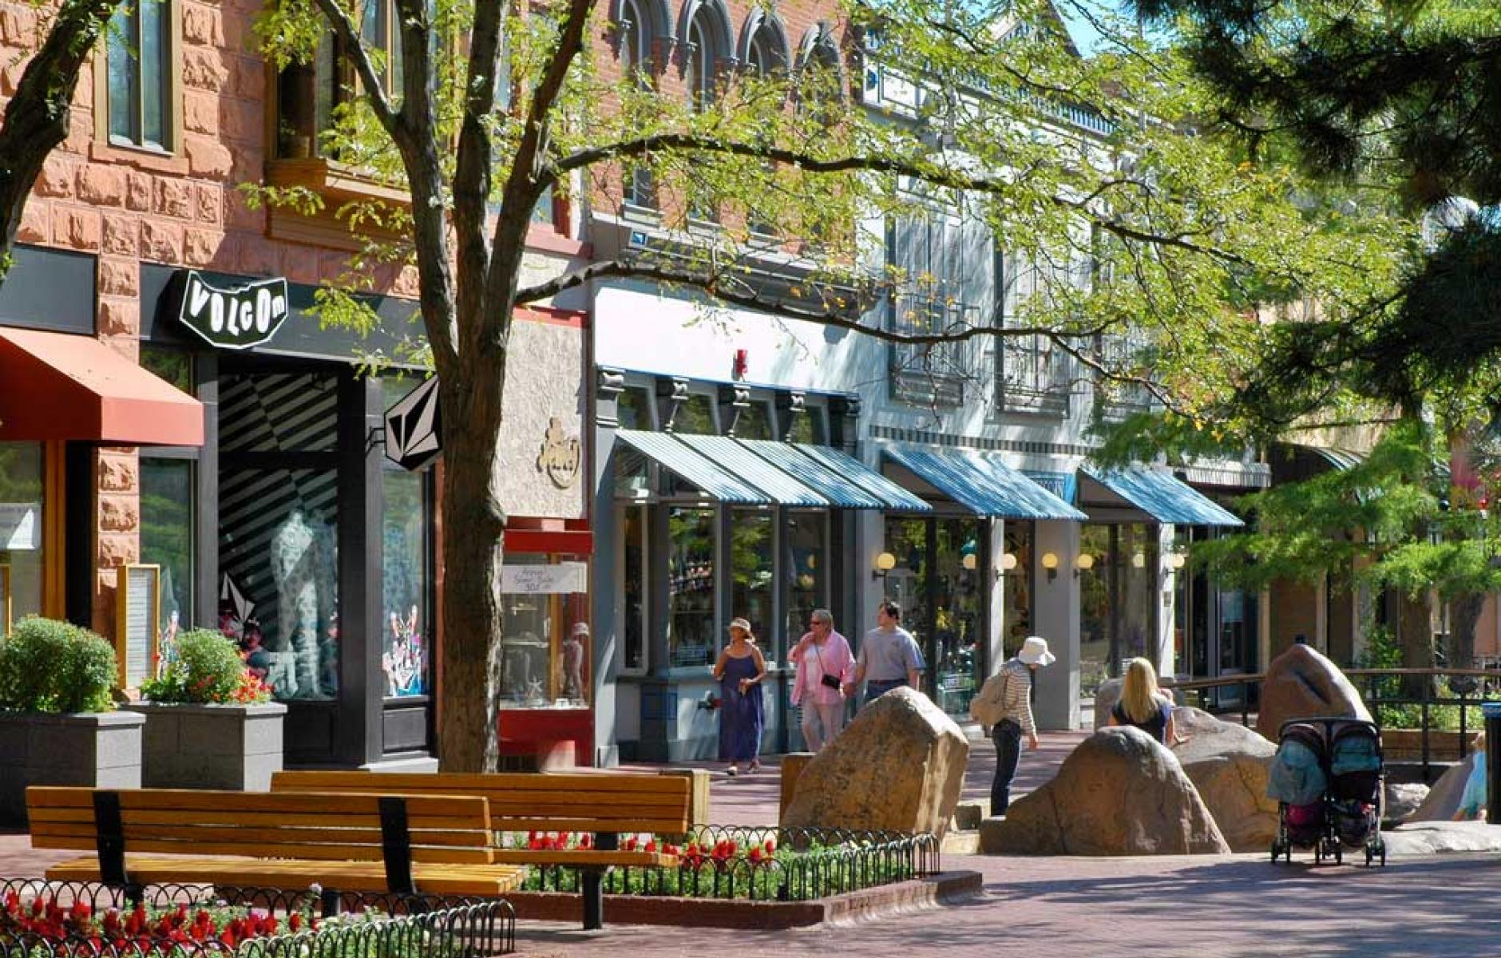
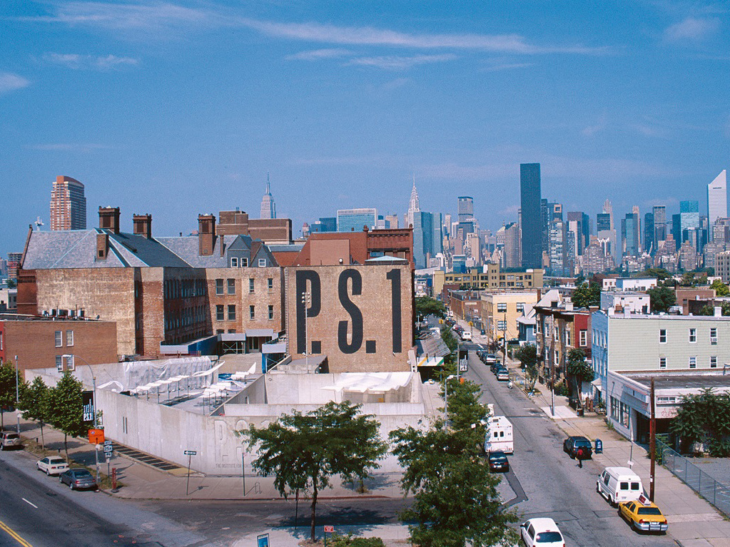
Through Jacobs – what it starts to be….

Slide 34
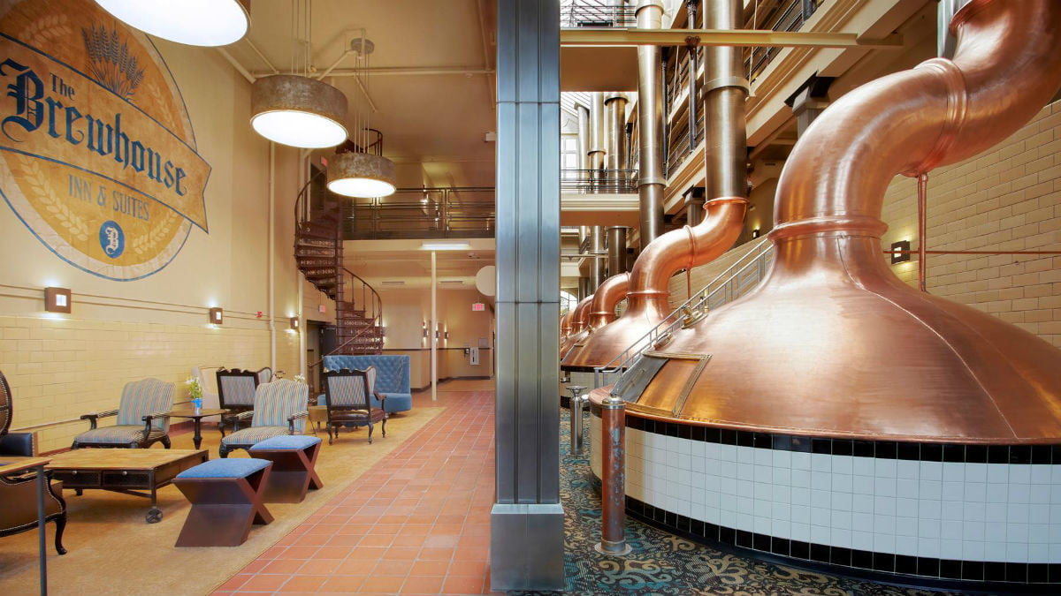
Questions? Thoughts? Examples?

Slide 35
A word (or two) on servant-leadership projects….
Walnut Way
MacCanon Brown Homeless Sanctuary
Adams Garden Park
“This is Milwaukee” project

Slide 36
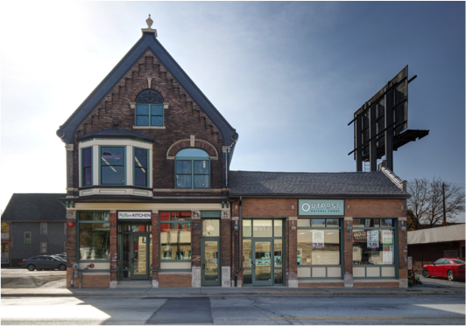
Walnut Way….
Health and mental health services available online as well as in-person
• An accessible online marketplace focused on neighborhood businesses
• An online approach to community engagement and organizing
• Accessible technology to connect neighbors and resources
• A technology platform that can integrate CWB’s multiple services and networks
• A micro loan/grant program to sustain entrepreneurial activity and address emergency needs

Slide 37
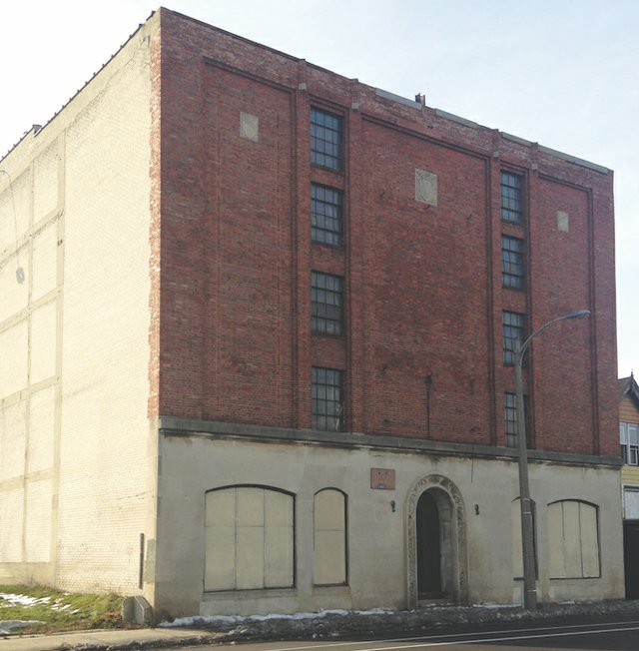
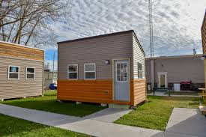
MacCanon Brown Homeless Sanctuary

Slide 38
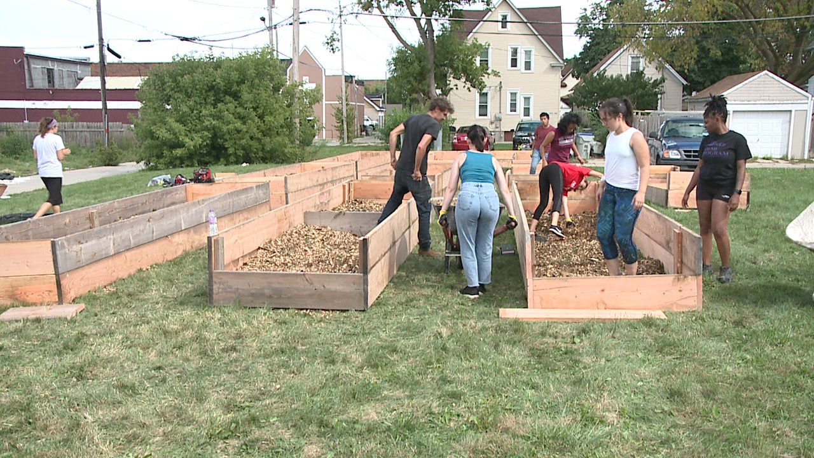
And brings in this as well….

Slide 39
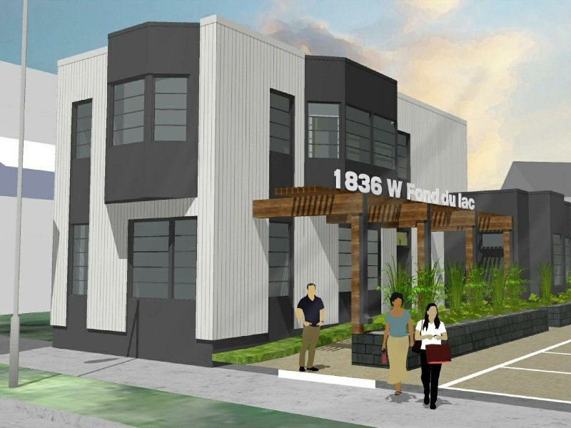
Adams Garden Park
Research, document, and potentially display the history of the building and the surrounding community….

Slide 40
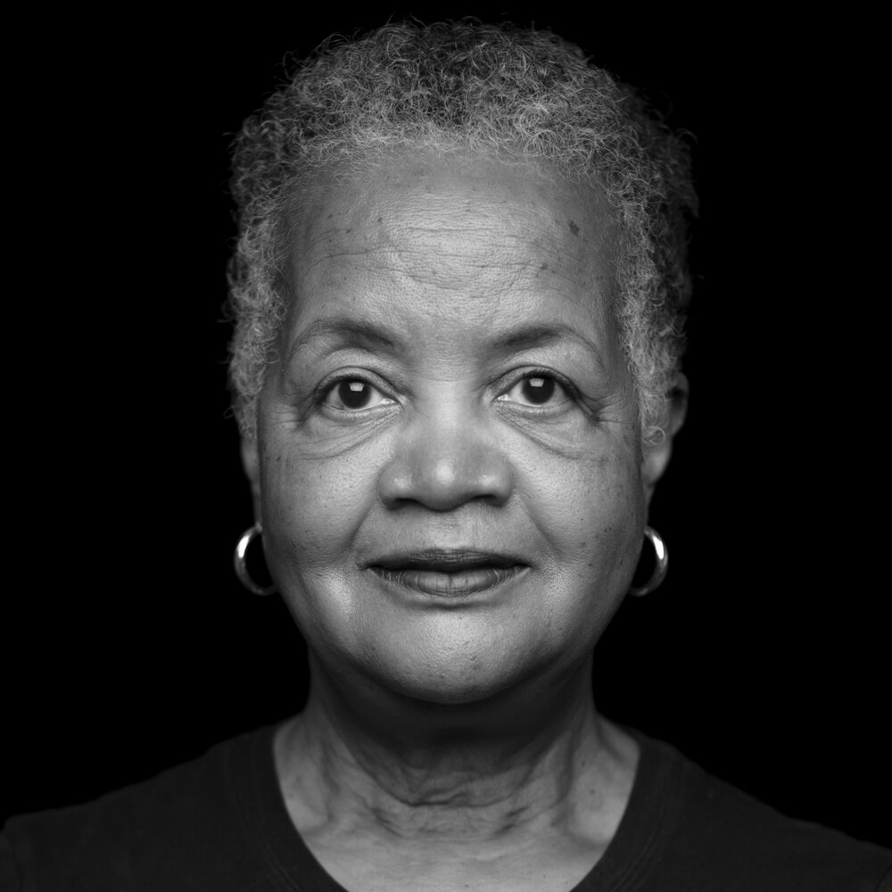
“This is Milwaukee” project
“We have interviewed nearly 100 Milwaukeeans who embody the notion of citizenship. Our project is a direct encounter with those individuals, many of whom are doing heroic work for our city right now. What does democracy look like here?”
How to get word out regarding the project in the pandemic era?

